Slide 1
REQUIREMENT ENGINEERING
JIMMA UNIVERSITY
JIMMA INSTITUTE OF TECHNOLOGY
FACULTY OF COMPUTING AND INFORMATICS
CHAPTER FIVE
REQUIREMENTS VALIDATION
Notes:
IT Project Management - ITec 2063

Slide 2
Topics we will cover
The need for requirements validation
Guidelines on what to validate
Resources needed for requirements validation
Techniques for validating requirements

Slide 3
Introduction
“A correct requirements document is not necessarily the right requirements document”
Requirements validation is the process of certifying the requirements document for correctness against the user's intention.
Validation ensures that the requirements:
  Achieve stated business objectives
  Meet the needs of stakeholders
Validating at the requirements can help to avoid fixing expensive bugs after the software has been developed.

Slide 4
Guidelines on what to validate in a requirements document
Requirements validation should be thought as more of a "debugging" activity rather than a "proving correct" one.
During the requirements validation process, different types of checks should be carried out on the requirements document.
Consistency checks: A requirements document is consistent if no contradicting conclusions can be derived from it.
Consider as an example a requirements model for a payroll application.
  If some requirement in the model states that "employees who earn less than 1000 should not be taxed" and at the same time a different requirement states that "for all employees tax should be deducted from their salaries" then the document is inconsistent.

Slide 5
Guidelines on what to validate in a requirements document
Non-ambiguity checks: ambiguities can be introduced in a requirements document , especially when natural language is used.
Imagine a document of requirements for a software controlled furnace.
One particular requirement states, “when the furnace temperature reaches 200 oC or the environment temperature falls below 5 oC and the water valve is turned on then the oil valve must be turned on.”
The above requirements statement is ambiguous because it can be interpreted in two different ways, i.e. as
when the furnace temperature reaches 200 oC and the water valve is turned on, the oil valve should be turned on. When the environment temperature falls below 5 oC and the water valve is turned on then the oil valve should be turned on
when the furnace temperature reaches 200 oC the oil valve must be turned on. When the environment temperature falls below 5 oC and the water valve is turned on, the oil valve must be turned on.

Slide 6
Guidelines on what to validate in a requirements document
Completeness Checks: Completeness is a difficult thing to check in a requirements model, since there is no formal procedure to do so.
A requirements document contains goals to be achieved in a problem domain, as well as rules, facts and constraints that apply to the domain and to the software system that will be operating in the domain.
  Failure to capture any of these ingredients of a requirements document will have an impact on the completeness of the document.

Slide 7
Guidelines on what to validate in a requirements document
Verifiability checks: Ensures that each requirement in the requirement document yields the right products.
Traceability Checks: Ensures that the source of each requirement in the requirement document must be clear.
Modifiability Checks: Ensures that the source of each requirement in the requirement document should be mapped.
“The main- problem of requirements validation is that there is no existing document which can be a basis for the validation”

Slide 8
Resources needed for requirements validation
Requirements Document
Analyst
Budget
“The main- problem of requirements validation is that there is no existing document which can be a basis for the validation”

Slide 9
Techniques for Validating Requirements
Requirements reviews
Prototyping
Model validation
Requirements testing

Slide 10
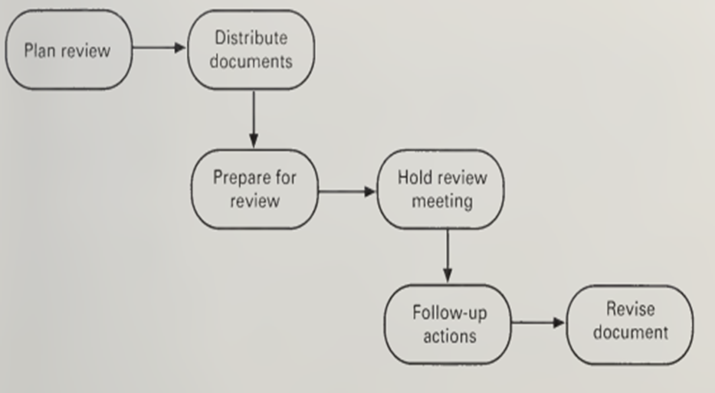
Requirements Reviews
A requirements review is a manual process that involves people from client, contractor and knowledge domain experts organizations
They look for problems, meet to discuss these problems and agree on a set of actions to address the identified problems. Inspection Steps

Slide 11
Requirements Reviews
Plan review: The review team is selected and a time and place for the review meeting is chosen.
Distribute documents: The requirements document and any other relevant documents are distributed to the review team members.
Prepare for review: The individual reviewers read the requirements document to identify conflicts, omissions, inconsistencies, deviations from standards and any other problems.
Hold review meeting :The individual comments and problems are discussed and a set of actions to address the problems is agreed.
Follow-up actions: The chair of the review checks that the agreed actions have been carried out
Revise document :The requirements document is revised to reflect the agreed actions. At this stage, it may be accepted or it may be re-reviewed

Slide 12
Requirements Reviews
Advantages
  Effective (even after considering cost)
  Allow finding sources of errors (not only symptoms)
  Requirements authors are more attentive when they know their work will be closely reviewed
    Encourage them to conform to standards
  Familiarize large groups with the requirements (buy-in)
  Diffusion of knowledge
Risks
  Reviews can be dull and draining (need to be limited in time)
  Time consuming and expensive (but usually cheaper than the alternative)
  Personality problems
  Office politics…

Slide 13
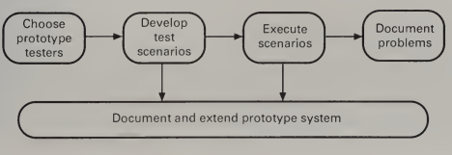
Prototyping
If you develop a prototype system to demonstrate requirements, stakeholders and other end-users find it easier to discover problems and suggest how the requirements may be improved.
If a prototype has been developed for requirements elicitation, it makes sense to use this later in the requirements engineering process for validation.
However, if a prototype system is not already available, it is not likely to be cost-effective to develop a prototype system only for requirements validation.

Slide 14
Prototyping
Choose prototype testers: The best testers are users who are fairly experienced and who are open minded about the use of new systems.
Develop test scenarios: Careful planning is required to draw up a set of test scenarios which provide broad coverage of the requirements.
Execute scenarios: It is best that users work alone because they are then more likely to use the system in a realistic way and will not be biased by the advice given by requirements engineers.
Document problems: Its usually best to define some kind of electronic or paper problem report form which users fill in when they encounter a problem or want to suggest some change to the system.

Slide 15
Techniques for prototyping
Animation: Animation is a technique which can be effectively brought into use for the validation of real-time systems.
  Real time systems have a common set of notions such as processes, process synchronization, messages and timers.
Natural Language paraphrasing: The technique of natural language paraphrasing has being devised in order to tackle the problem caused by two conflicting concerns in Requirements Engineering, namely the concern of the analyst to develop a formal requirements model, and the users’ need to communicate their requirements in their own terminology.
Expert System Approaches: The approach is expected to carry the validation process on its own

Slide 16
Model validation
Part of the requirements specification for a system may consist of one or more system models: System Architecture, Class Diagram, Use case Diagram etc.
The validation of these models has three objectives.
  To demonstrate that each individual model is self-consistent.
  To demonstrate consistency: Entities which are referenced in more than one model should be defined to be the same in each model, comparable items should have the same names and the model interfaces should be consistent.
  To demonstrate that the models accurately reflect the real requirements of system stakeholders

Slide 17
Requirements Testing
A desirable attribute of requirement is that it should be testable.
Each functional and non-functional requirement in the requirements document should be analyzed and a test defined which can objectively check if the system satisfies the requirement.

Slide 18
Key Points
The need for requirements validation
Guidelines on what to validate
Resources needed for requirements validation
Techniques for validating requirements

Slide 19

Any Question?

